Slide 1
Microsoft 365 Enterprise
F1 / E3 / E5 License Map – July 2019
@AaronDinnage

Slide 2
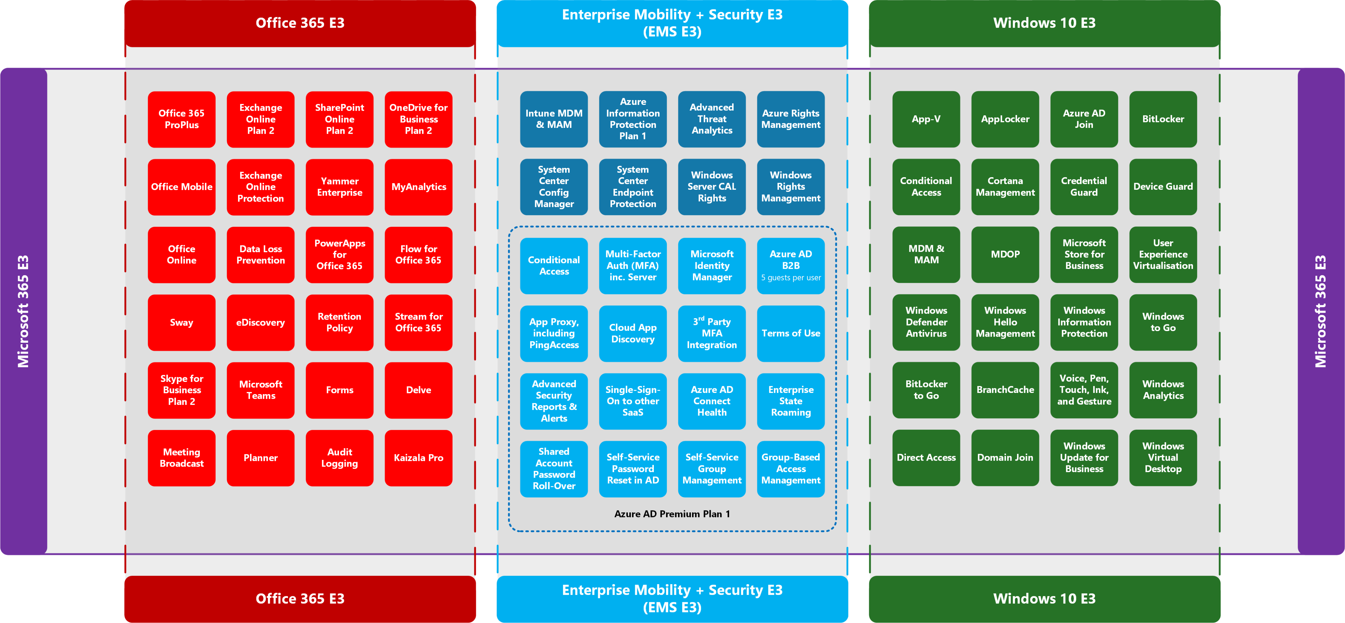
@AaronDinnage

Slide 3
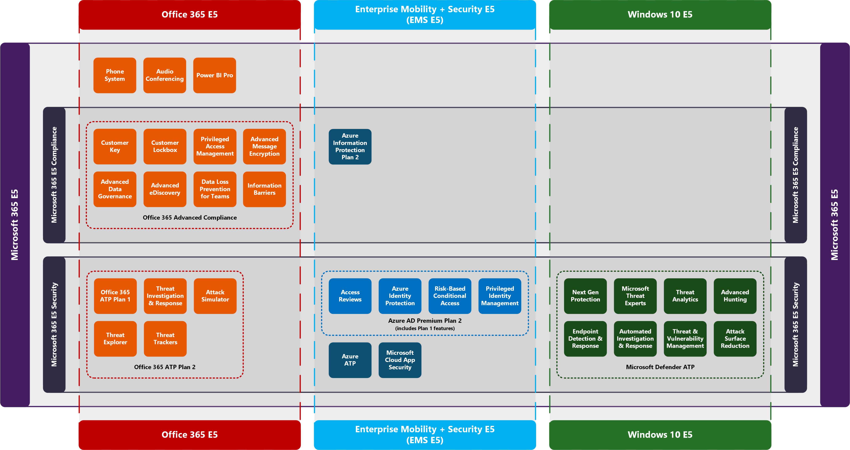
@AaronDinnage

Slide 4
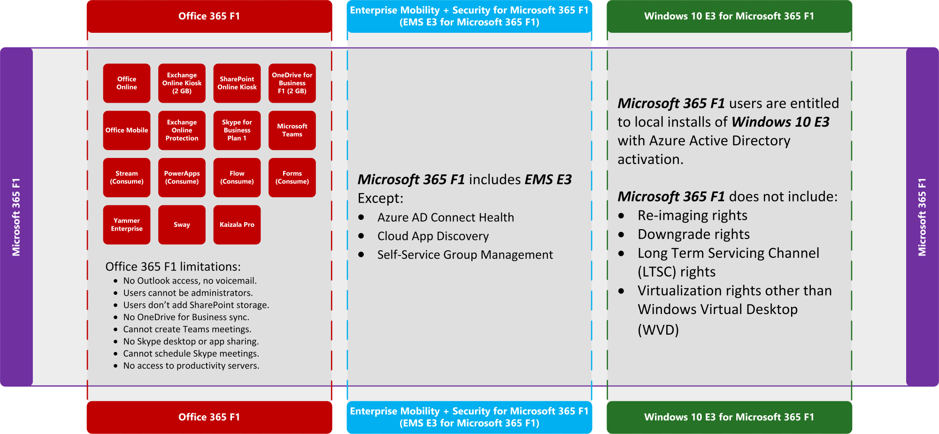
@AaronDinnage

Slide 5
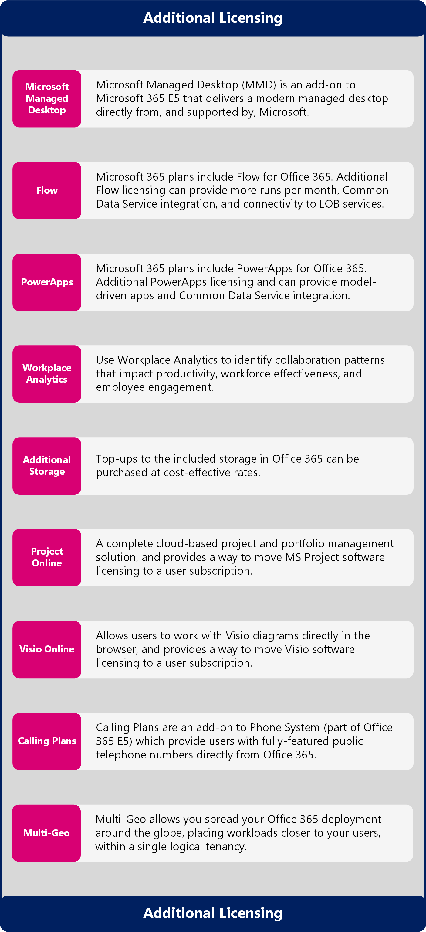
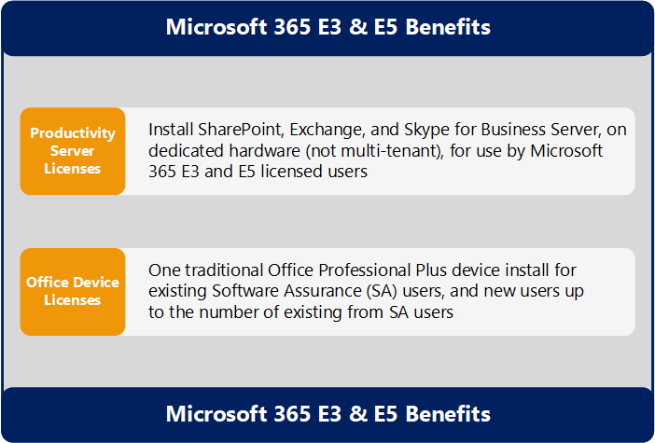
Microsoft 365 Benefits and Additional Licensing
https://github.com/AaronDinnage/Licensing

